Slide 1
Food and Beverage Management fifth edition
Chapter 10
Making Strategic Decisions

Slide 2
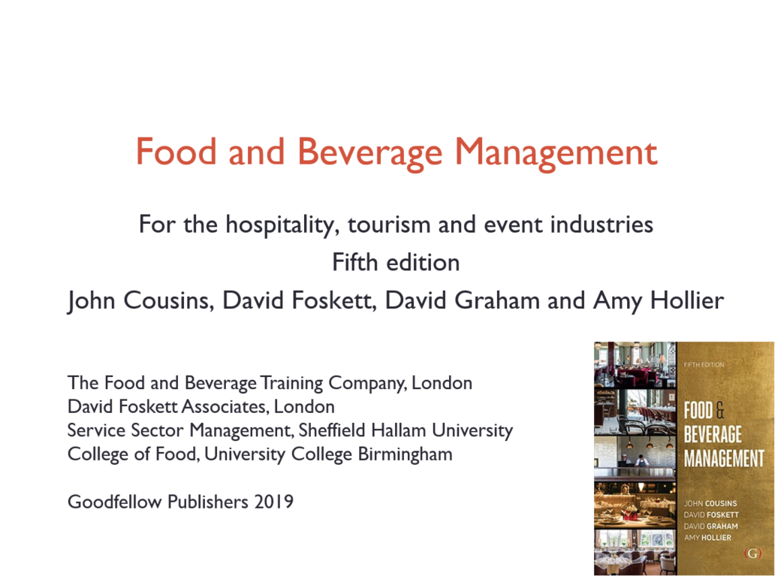

Slide 3
Chapter 10 covers:
The origins of strategy
Assessing current performance
Assessing organisational capability
Strategic analysis and planning
The need for a balanced approach
The basis of strategy
Strategic direction and strategic means
Evaluation criteria

Slide 4
Origins of strategy
Strategic decisions are:
  Major decisions that affect the direction to which an organisation, or part of an organisation, is committed for the next few years
  Decisions which involve a significant commitment of resources
  Decisions which involve complex situations at corporate, business unit and operational level which may affect and be affected by many parts of the organisation

Slide 5
Terms used include:
Vision
Mission
Policy
Goals/aims
Strategy
Objectives
Tactics

Slide 6
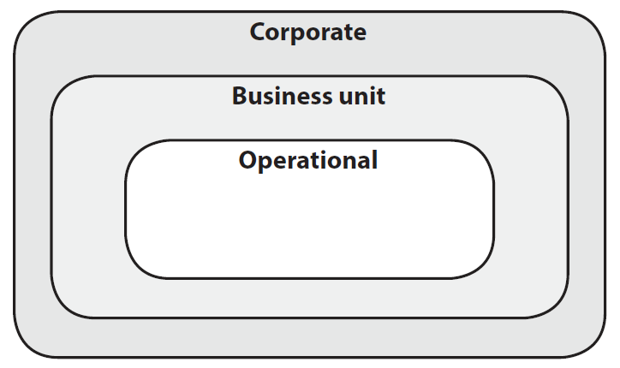
The three levels of strategy

Slide 7
Assessing current performance
Same three levels used when assessing the performance of the current operation:
  Operational
      includes day-to-day sales and the way the product is provided and promoted
  Business
      the performance of the enterprise in terms of profitability, competitiveness and other business measures
  Corporate
      the strategic direction of the operation and how this is being achieved

Slide 8
Assessing current performance
Quantitative analysis
Business environment analysis
Qualitative evaluation

Slide 9
Quantitative analysis
Essential part of appraisal
Considered over time
Evaluation is more important than the data itself

Slide 10
Quantitative analysis can:
Identify trends and progress
Enable comparisons with the competition and the industry as a whole
Reveal lost profit and growth potential
Identify areas needing improvement
Highlight and emphasise possible danger areas

Slide 11
Ratio analysis
Includes:
  Operational ratios
  Activity ratios
  Profitability ratios
  Liquidity ratio
  Gearing ratios
  Stock market ratios
The formulae and explanations of what the indi­vidual ratio can indicate, are detailed in Appendix A Food and Beverage Management 5th edition, Cousins et. al. 2019

Slide 12
Business environment appraisal
Macro-environment
  PESTLE
Industry micro-environment
  Porter’s Five forces

Slide 13
The business macro-environment
P Political
E Economic
S Socio-cultural
T Technological
L Legal
E Ecological (environmental)

Slide 14
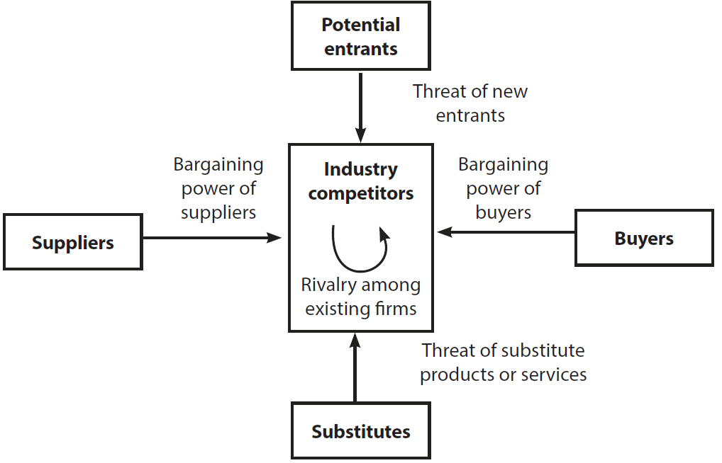
The business micro-environment
Porter’s Five Forces
Adapted from Porter 2004

Slide 15
Qualitative evaluation
Should be used as an additional tool to back up issues identified in another area of analysis
The evaluation of the quantitative analysis is more important than figures themselves
Qualitative evaluation supports:
  Making informed evaluation of the business
  Allowing for external comparison
  Ensuring the right questions are asked

Slide 16
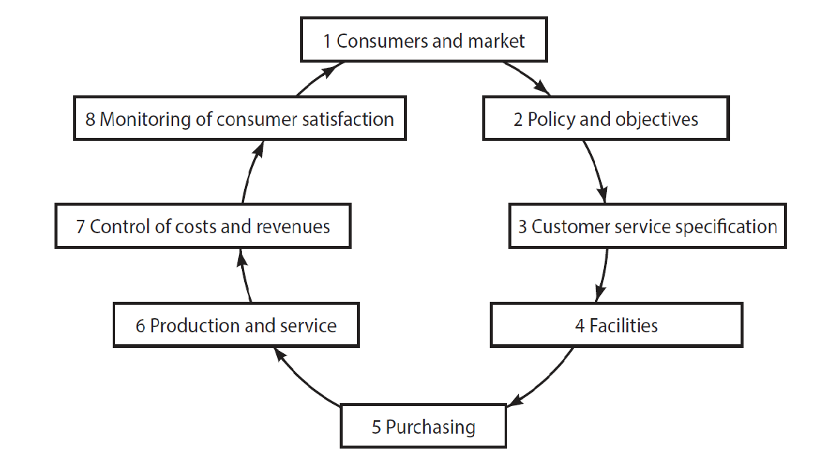
Analysis using the Food Service Cycle

Slide 17
The Food Service Cycle
Difficulties in one element of the cycle will cause difficulties in the elements of the cycle that follow
Difficulties experienced under one element of the cycle will have their causes in preceding elements

Slide 18
External comparison
With other organisations generally
With other similar organisations
Against industry norms
Through benchmarking

Slide 19
Quantitative measures
Can draw attention only to things that can be easily measured
Performance indicators measure behaviour, but can also change behaviour to only satisfy the indicator
Some of the indicators are prone to being manipulated to give the impression of higher quality than is actually being achieved

Slide 20
Assessing organisational capability
Resource analysis
  How well do we do what we do?
  Existing capacity for change
  Identifying changes in resources
Value chain analysis
  Examine all stages of the food service cycle

Slide 21
Strategic analysis and planning
Seeks to manage the interface between:
  The external environment
    (opportunities and threats)
    and
  The internal capabilities of the operation
    (strengths and weaknesses)

Slide 22
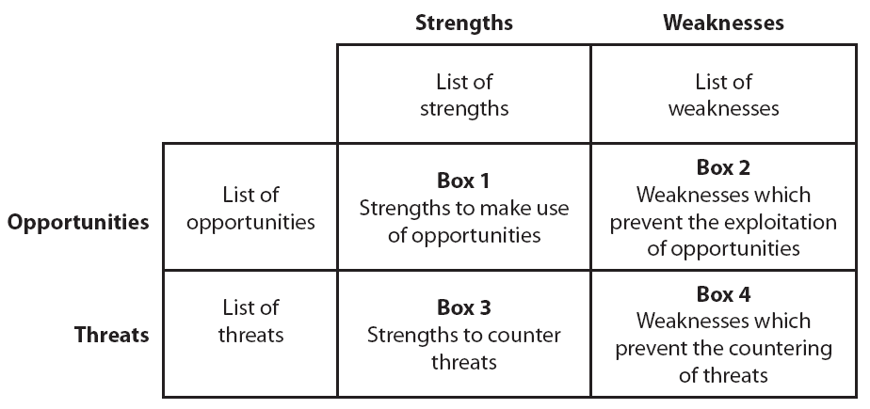
SWOT matrix

Slide 23
Using the SWOT analysis
Need for constant monitoring
Assess for now and the future:
  What possible external changes might make a current strength into a weakness, or vice versa?
  How can current strengths be used to explore future opportunities?
  Are current resource capabilities able to meet future demands?

Slide 24
Need for a balanced approach
Decision making must take account of four perspectives:
  Developmental – organisational capacity, knowledge and innovation
  Operational – efficiency
  External – stakeholder and customer satisfaction
  Financial – performance and financial management
Balanced Scorecard Institute

Slide 25
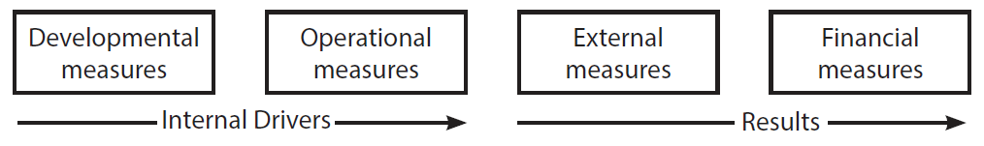
Balanced Scorecard
Organisations need to know:
how the Internal Drivers are contributing to the Results
Source: Developed from Johnston et al. 2012

Slide 26
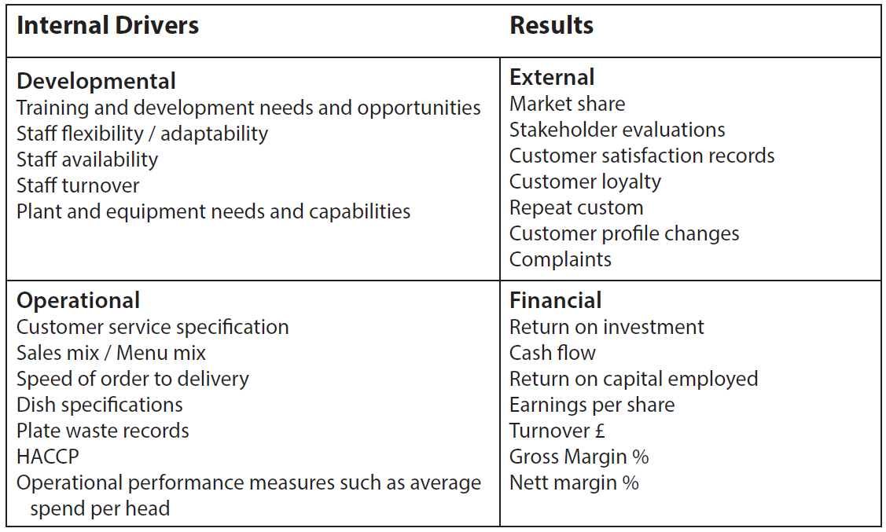
Examples of performance indicators

Slide 27
Strategy is a means to an end
“Would you tell me please which way I ought to go from here?” she asked.
“That depends a good deal on where you want to get to,” said the cat.
Lewis Carroll, Alice’s Adventures in Wonderland (1865)

Slide 28
Strategy is a means to an end
Where do you want to get to? | Where are you starting from? | Which way ought you to go?
Objective | Current position | Strategy

Slide 29
Basis of strategy
  1. Cost leadership
  2. Differentiation
  3. Focus
    3a. based on cost
    3b. based on differentiation
Michael Porter (2004a)

Slide 30
Porter’s matrix
Adapted from Porter 2004

Slide 31
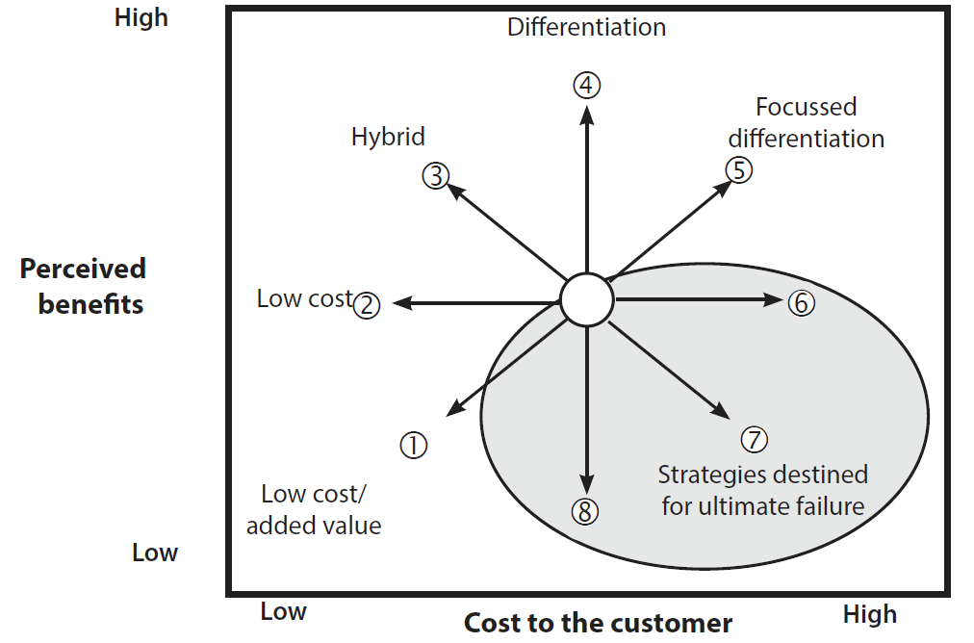
Strategy Clock
Eight possible
strategic routes
Adapted from Johnson et al. 2008 and 2017

Slide 32
Strategic direction
Various approaches can assist, including:
  Growth Share (BCG) Matrix
  Life cycle analysis
  Ansoff’s growth matrix

Slide 33
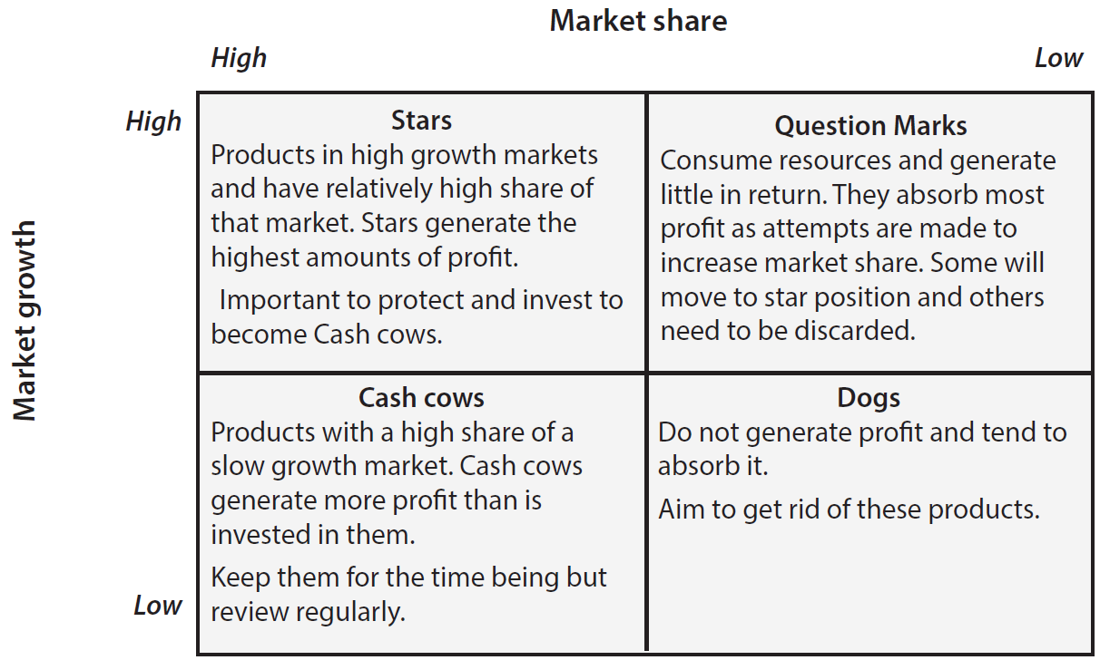
Product Portfolio Matrix
Boston Consulting Group

Slide 34
Life cycle analysis
Stages
  Introduction – Growth – Maturity - Decline
Market position
  Dominant – Strong – Favourable – Tenable – Weak
Variants
  Fad life cycle
  Extended life cycle

Slide 35
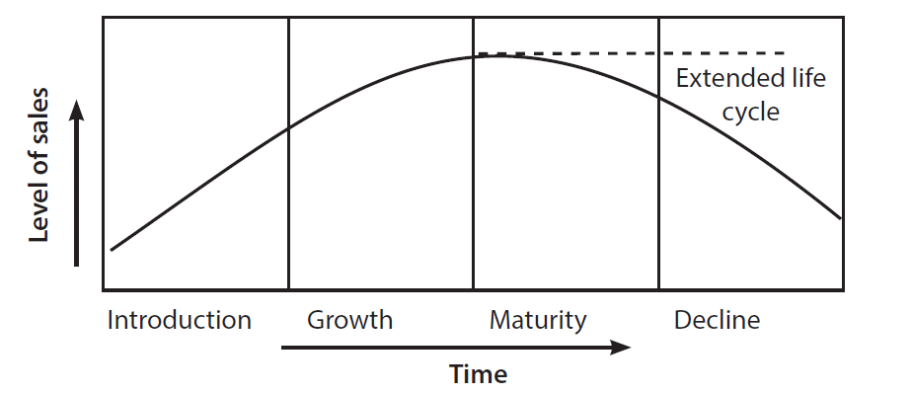
Life cycle analysis

Slide 36
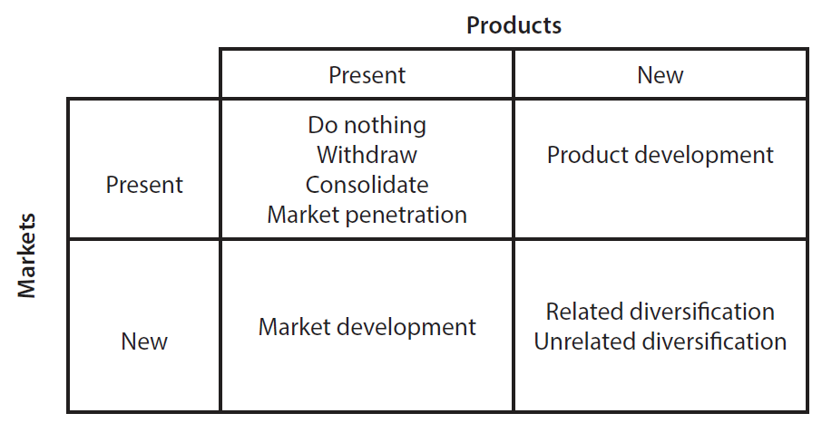
Ansoff’s growth matrix
Adapted from Ansoff 1988

Slide 37
Strategic means and assessing options
Strategic means
  Internal development
  Mergers and acquisitions
  Joint development
Evaluation criteria for options
  Suitability
  Feasibility
  Acceptability

Slide 38
Strategy and organisations
If approaches to strategic management were only undertaken in a wholly scientific way, decisions would only be rational and objective
But organisations are complex, and decisions about strategy are largely dependant on the predominant organisational characteristics
This help to indicate why similar food service businesses, facing similar business environments, might make quite different strategic decisions

Slide 39
Reality of strategic management
Organic not linear
Affected by organisation and culture
Complex and judgmental
Continuous process
Combines a variety of approaches and techniques
A management job
Needs to be flexible to cope with uncertainty

